Slide 1

Online education hub Guide name :- prof.Shaikh Mohd Ashfaque
Group members name :-
Wasimuddin Zakirhussain mallick (SE computer )
ARSHAD ABU SAEED KHAN ( se computer)
Khan sabir mohd umar ( se computer)
Khan shamimmurraza ( se computer)

Slide 2
Problem statement :-
we know that this type of website already exist but they cost high just to provide notes and question for practise and some time there will no lecture in few web app, even of YouTube lecture links will not be available.
We had also face this problems that’s why this is the reason of our motivation to work on this project.
Now students don’t have to search 10 different website for free notes and questions for practice and also for YouTube lectures.

Slide 3
Literature survey:-
Provides Notes & Study Material For Free. This is a Very Important Point For those Who Can’t Afford. They Also Has Paid Plan But Work Can Easily be Done in Free Version too.
Some Websites Have Ads on their Website. This is Annoying. When we Go on Downloading it is keep redirecting on other scam websites. ( lecturenotes.in ) Doesn’t Have any Ads.
Content is Latest & Updated. As this is online it is Easy to do so. So You Don’t Have to Worry About Whether Your Notes are Updated or Not. Admin Has Access to Change the Material. An exact copy of the original can be made any number of times without any degradation in quality.
Physical books are still more popular than eBooks ( Study Related ). But the number of people reading books the digital format has been increasing consistently. The younger readers opt for digital versions of books to read the content anytime and anywhere. Also, they can access the eBooks anytime and anywhere using their mobile devices.
The only thing that is dislike is probably one of the worst thing of the website they offers a lot of stuff in which students gets confused

Slide 4
Application and benefits:-
Students can find the required information instantly. Also, they can use the search option to find and sort digital resources by simply entering relevant words and phrases. The user is able to use any search term bellowing to the word or phrase of the entire collection
Online Education Hub enable readers to read eBooks ( Study Related), Notes, and watch videos 24 hours a day. The readers can access and read the library materials in digital format anytime and anywhere using their preferred devices. Provides access to much richer content in a more structured manner
With the much larger volume of digital information, finding the right material for a specific task becomes increasingly difficult.
Online Education Hub will not need high band for transfer of multimedia resources but the band width is decreasing day by day due to its over utilization.
Online courses offer students greater flexibility to study while balancing commitments and user should be able to take courses anywhere through any devices

Slide 5
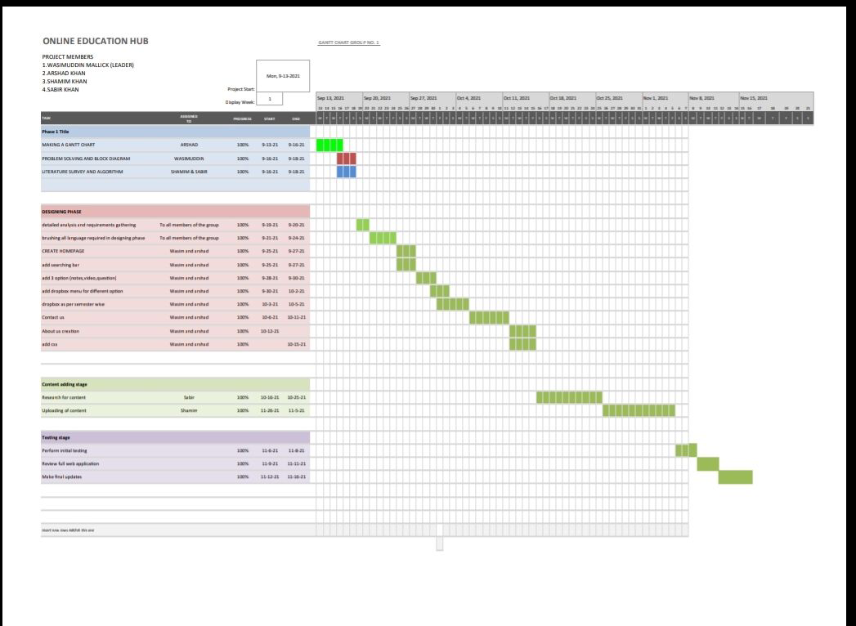
Gantt chart

Slide 6

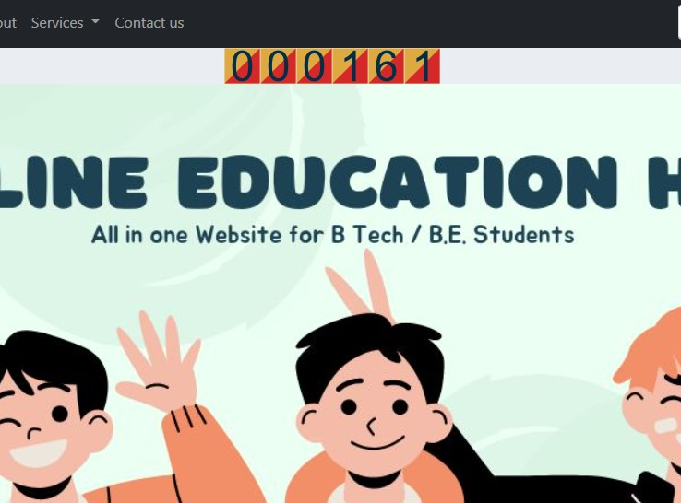

Implementation of project
Front page of website
Top heading Shows no. of user visited.

Slide 7
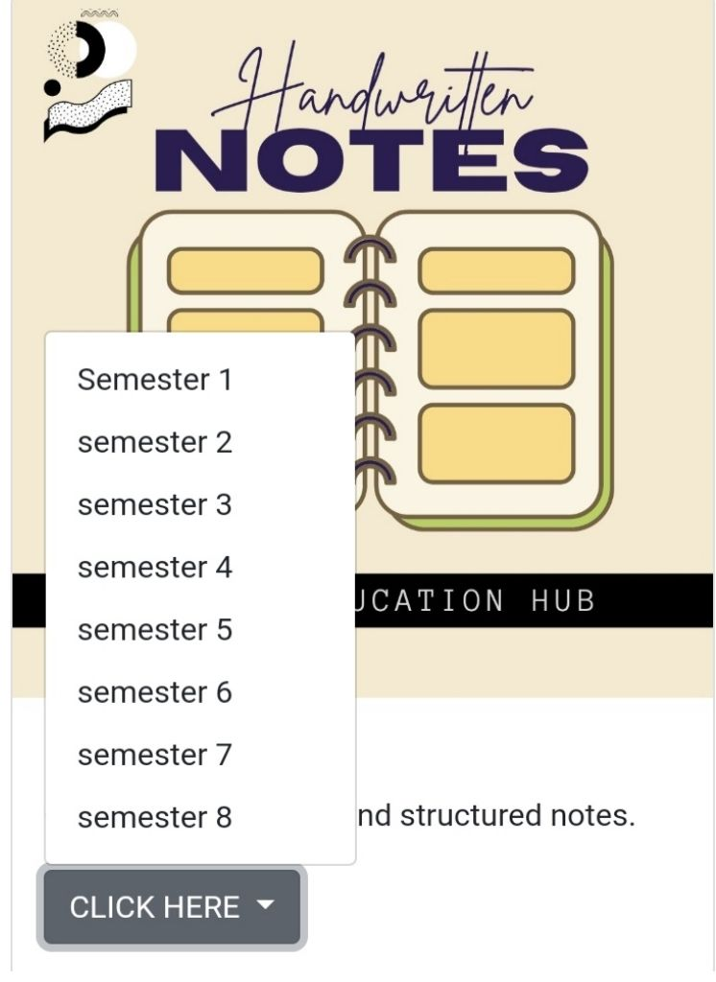
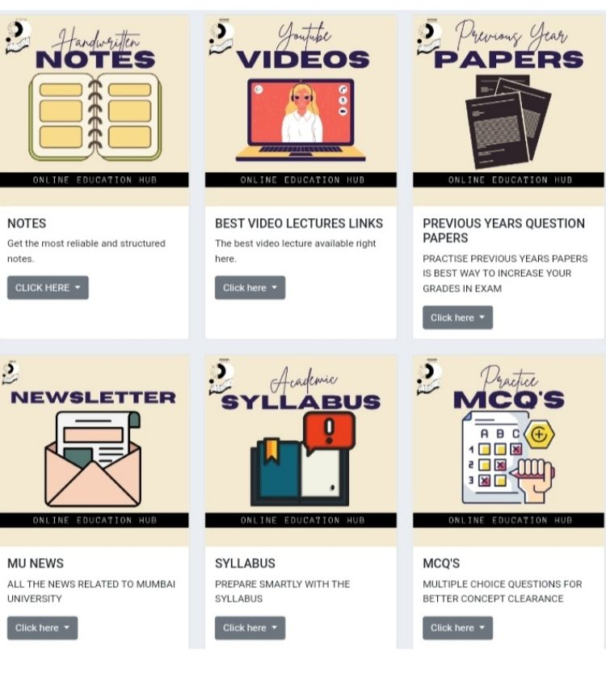
Implementation of project
This will ask if you try to access any material
Bottom view

Slide 8
Conclusion:
Online Education Hub Purpose Was to Provide Valuable and Essential Content to Engineering Student in One Website. This project was a valuable learning experience for all of us. It has helped us develop our existing skills. Working on this project, we unearthed hidden talents, making us aware of our strengths and weaknesses. We also learned various new computer and programming languages like CSS, HTML, C, C++ etc. All this would not be possible without good teamwork and making us realize the importance of teamwork. There is a lot to be Done in Future. Like Proper Updates , Giving Proper Guidance and Better Service to the Users.

Slide 9
THANK YOU

